Slide 1
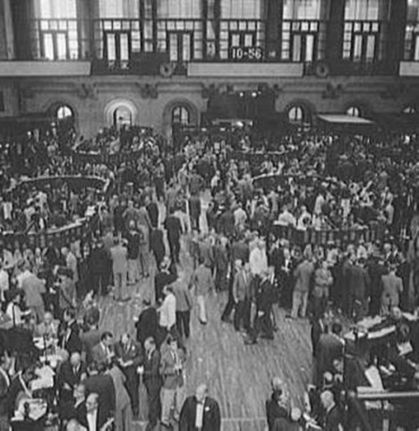

Stocks The Stock Markets Stock Splits
*All pictures and graphics are not FDM’s property. They are purely visual and for decorative purposes. The sources used are Google and Getty images. Pictures on this slide: NYSE 1920’s and 2016.

Slide 2

Lesson Objectives
After completing this Lesson you will be able to:
List some types of Financial Markets and describe
their purpose
List the types of Capital Markets
List the types of Stock Markets
Define share/stock, dividend and shareholder/stockholder
Define the two types of stock
Define Authorized Shares, Unissued Shares,
Restricted Shares, Float Shares and Outstanding Shares
Define stockbroker
List the types of Stock Markets
List the largest (Secondary) Stock Markets
Describe the purpose of Stock Splits
Describe the purpose of Reverse Stock Splits

Slide 3
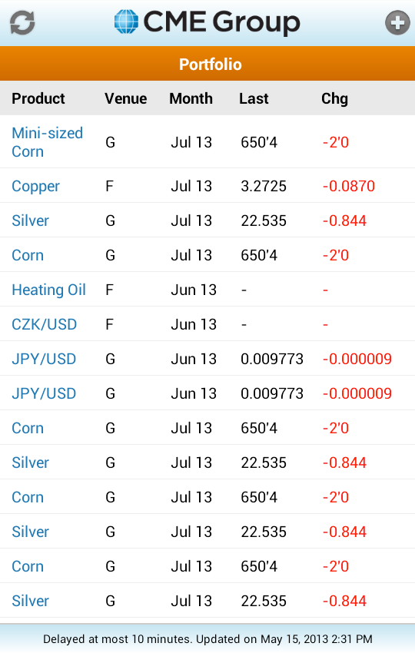

Types of Financial Markets
Capital markets
Money markets
Commodity markets
Derivatives markets
Futures markets
Insurance markets
Foreign Exchange markets
Commodity Prices 2013
A “Farmers’ Market” is a type of Commodity Market

Slide 4
Financial Markets
What is the Purpose of Financial Markets?
Price discovery: Buyer and Seller determine price of assets
Liquidity: Presence of buyer and seller ready to trade.
Reduce cost: Presence of a Financial Market reduces search cost. Information cost also decreases because prices reflect aggregated information collected by all market participants.

Slide 5

Capital Markets
Stock markets:
Provide financing through the issuance of shares or common stock, and enable the subsequent trading thereof.
A share of stock is the smallest unit of ownership in a company.
The shareholder or stockowner therefore owns a part of the company, called shares or stocks.
When the company makes money, a share of their income is paid as a dividend to the shareholder.
Bond markets:
Provide financing through the issuance of bonds, and enable the subsequent trading thereof.

Slide 6

Stock Market Types
Primary Markets:
Raise funds for the Company
Securities/Bonds sold by the
Company for the first time
Purchased by Banks and
resold on the Secondary
Markets
The primary market is also known
as the new issue market (NIM)
because shares change from
being unissued to issued when
such trades are made.
Secondary Markets:
Initial Public Offering (IPO):
Initial sale of a new stock on a Stock Market
Buying/Selling
Day-to-day transactions
The Secondary Markets are called “The Stock Markets” in the media.
NYSE “virtual tour”: http://www.businessinsider.com/new-york-stock-exchange-tour-2013-4
A Stockbroker’s Day: http://www.businessinsider.com/heres-what-a-nyse-floor-broker-does-2012-10
IPO for US. Foods at NYSE May 2016

Slide 7
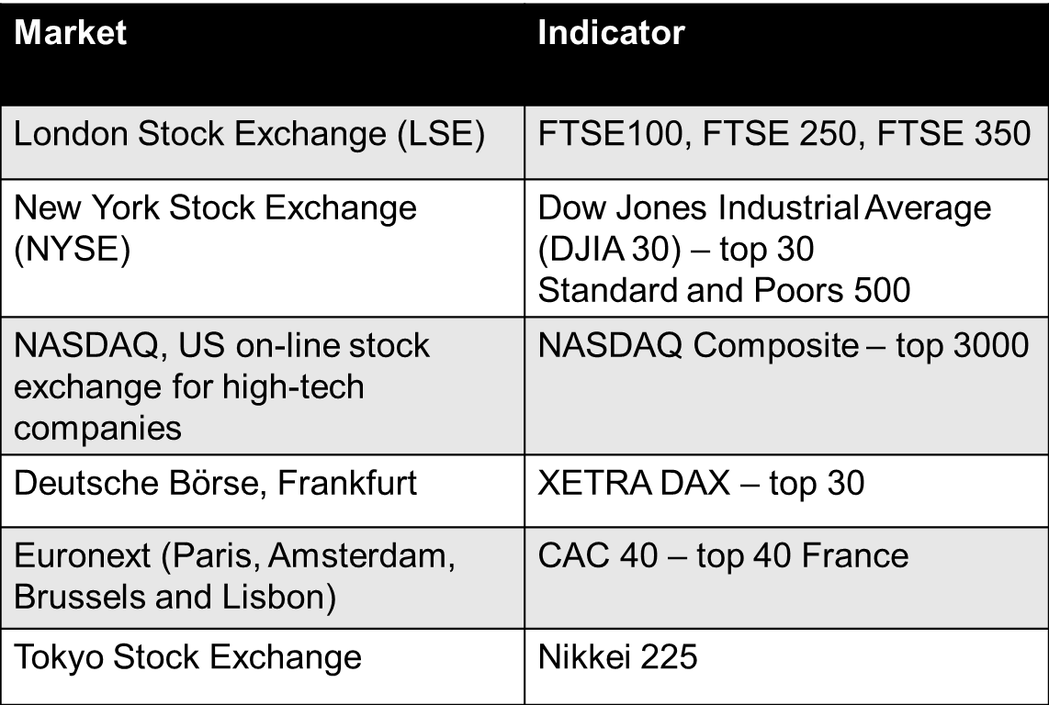
The Largest (Secondary) Stock Markets

Slide 8
Stock Terms (1)
There are two types of stock:
Common stock:
Most of the stock held by individuals is common stock.
Common stock represents the majority of stock held by the public. It has voting rights, along with the right to share in dividends.
When you hear or read about “stocks” being up or down, it always refers to common stock.
Preferred stock:
Despite its name, preferred stock has fewer rights than common stock, except in one important area – dividends.
Companies that issue preferred stocks usually pay consistent dividends and preferred stock has first call on dividends over common stock.
Investors buy preferred stock for its current income from dividends.
https://www.thebalance.com/introduction-to-stocks-3141368

Slide 9
Stock Terms (2)
Authorized Shares:
These shares represent the total number of shares of stock authorized by the Company’s Board of Directors.
Only a vote by the shareholders can increase this number of shares.
Also known as "authorized shares" or "authorized capital stock."
However, just because a company authorized a certain number of shares doesn’t mean it must issue all of them to the public. Most companies retain shares for use later called unissued stock or shares.
Unissued Shares:
Shares a company retains in its treasury and not issued to the public or to employees are unissued shares.
They are also called “Treasury Shares” or “Treasury Stock”
https://www.thebalance.com/understanding-stock-share-terms-3141367

Slide 10
Stock Terms (3)
Restricted shares:
Company stock used for employee incentive and compensation plans. Restricted stock owners need permission of the SEC to sell.
There is a waiting period after a company first goes public where insiders’ restricted stock is frozen.
When insiders want to sell their stock, they must file a form with the SEC declaring their intention. Even insiders of established companies must file with the SEC before selling their restricted stock.
Float Shares:
Float refers to the number of shares actually available for trade on the open market. You and I can buy these shares.
Outstanding Shares:
Outstanding shares includes all the shares issued by the company, which would be the restricted shares plus the float.
https://www.thebalance.com/understanding-stock-share-terms-3141367

Slide 11

What is a Stockbroker?
A stockbroker, also called a Registered Representative, investment advisor or simply, broker, is a professional individual who executes buy and sell orders for stocks and other securities through a stock market, or over the counter, for a fee or commission.
Brokers must be registered to trade
at a specific exchange in order
to conduct legal trades in
that exchange.
A broker can be registered to trade
in any number of stock exchanges.
Stock exchanges have many
registered brokers.
http://www.investopedia.com/terms/s/stockbroker.asp

Slide 12
What is a Stock Split?
A Stock Split occurs when a Company decides to lower the price of a share of its stock without lowering the value of the Company
Here’s an example:
Amalgamated Kumquats, which is currently priced at $80 per share, announces a 2-for-1 stock split.
If you own 100 shares before the split worth $8,000, you will own 200 shares worth $8,000 after the split.
The market automatically marks down the price of the stock by the divisor of the split.
The $80 per share price becomes $40 per share.
There are other splits such as 3-for-1 and 3-for-2, however 2-for-1 seems the most common.
It terms of what your holdings are worth, nothing changes. In terms of what the company is worth, nothing changes. So, why do it?
https://www.thebalance.com/understanding-stock-splits-3141376

Slide 13
Why split a Stock?
Perception
Some companies worry when the per share price gets too high that it will scare off some investors, especially small investors.
Splitting the stock brings the per share price down to a reasonable level.
Liquidity
If a stock’s price rises into the hundreds of dollars per share, it may reduce the trading volume.
Increasing the number of outstanding shares at a lower per share price aids liquidity.
https://www.thebalance.com/understanding-stock-splits-3141376

Slide 14
What is a Reverse Stock Split? (1)
Many companies attempt to list their common stock and preferred stock on one of the major stock exchanges, such as the NYSE, so they can offer greater liquidity to shareholders.
In order to earn and maintain exchange listing, the corporation must meet several criteria:
A minimum number of round lot holders (shareholders owning more than 100 shares)
An absolute number of shareholders
A specific net income threshold
A total number of public shares outstanding
A minimum stock price
https://www.thebalance.com/what-is-a-reverse-stock-split-357345

Slide 15
What is a Reverse Stock Split? (2)
These requirements are designed to ensure that the common stocks classified as exchange traded securities are only made up of reputable, respected, financially viable enterprises that represent a major engine of economic productivity in the United States.
That doesn't mean they'll be good investments - historically, some have gone bankrupt, leaving their investors with painful losses - only that the business is large enough to meet the standard of the exchange.
https://www.thebalance.com/what-is-a-reverse-stock-split-357345

Slide 16
What is a Reverse Stock Split? (3)
Reverse Stock Splits Can Help Investors Maintain Liquidity and the Company to Avoid the Embarrassment of “Delistment” (removal) from the Exchange.
In order to avoid the embarrassment and practical disadvantages of being delisted, the Board of Directors of a corporation may declare a reverse stock split for the sole purpose of increasing the nominally quoted market value of its shares.
The move has no real economic consequences and, in theory, is neither good nor bad for stockholders in and of itself.
https://www.thebalance.com/what-is-a-reverse-stock-split-357345

Slide 17
A Reverse Stock Split Announcement
BERKELEY, Calif., Oct. 14, 2016 (GLOBE NEWSWIRE) –
XOMA Corporation (Nasdaq:XOMA), a leader in the discovery and development of therapeutic antibodies, today announced that, at a special meeting of the Company's stockholders held on October 14, 2016, its stockholders voted to approve a reverse stock split of the Company's issued and outstanding common stock.
XOMA's Board of Directors then determined that the split would be at a ratio of 1-for-20.
Upon the effectiveness of the reverse stock split, every 20 shares of XOMA common stock will be converted into 1 share of common stock.
No fractional shares will be issued in connection with the reverse stock split.
A stockholder who otherwise would have been entitled to receive a fractional share of stock as a result of the reverse stock split will instead receive cash in lieu of fractional shares.
The reverse stock split is intended to enable XOMA to regain compliance with the $1.00 minimum bid price required for continued listing on the NASDAQ Global Market and help increase shareholder interest in our stock.
The reverse stock split will affect all stockholders uniformly and will not affect any stockholder's ownership percentage of XOMA's shares (except to the extent that the reverse stock split would result in some of the stockholders receiving cash in lieu of fractional shares).
https://www.thestreet.com/story/13854380/1/xoma-announces-reverse-stock-split.html

